Slide 1


Health Care and the ADA:
Including People With Disabilities
ADA National Network Learning Session
“The Basics of Health Care and the Americans with Disabilities Act (ADA)”
The Session is Scheduled to begin at 2:30 pm ET
Telephone Option: 805-309-2350 Access Code: 5552153 (not a toll free #)
Local numbers can be found at: http://adapresentations.org/local_numbers.php
Real-time captioning can be accessed by choosing the icon in the Audio & Video panel.
The content and materials of this session are the property of the ADA National Network and the presenters and cannot be used and/or distributed without permission. For permission to use training content or obtain copies of materials used as part of this program please contact adatech@adapacific.org

Slide 2
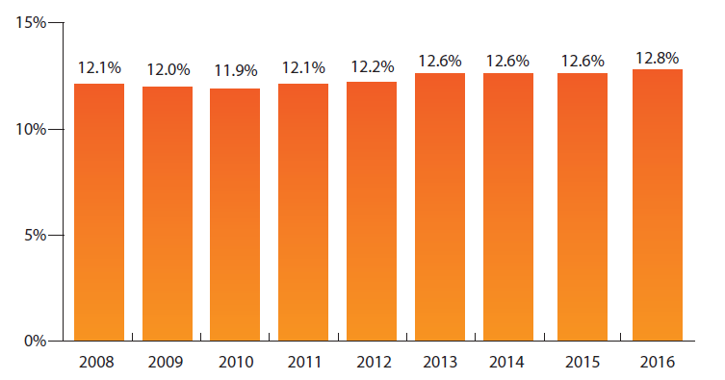
Percentage of People in the US with Disabilities, 2008-2016
Data Source: 2008-2016 American Community Survey, American FactFinder, Table B1810
Kraus, L., Lauer, E., Coleman, R., and Houtenville, A. (2018). 2017 Disability Statistics Annual Report. Durham, NH: University of New Hampshire. Available from http://disabilitycompendium.org/sites/default/files/user-uploads/2017AnnualReportSlideDeck
Notes:
Over the past years, the consistency of the disability questions used in the survey allows for a look at the percentage of people with disabilities over time. The percentage of those with disabilities in the US civilian population slowly increased from 11.9% in 2010 to 12.8% in 2016.
*Other surveys have publicized other rates of disability. These rates are affected by survey question, method, and other factors. Each survey has strengths and weaknesses. Comparing disability data between surveys is discouraged by all survey organizations. We have used the ACS due to its larger sampling, consistent year to year questions, and multitude of variables to examine.

Slide 3
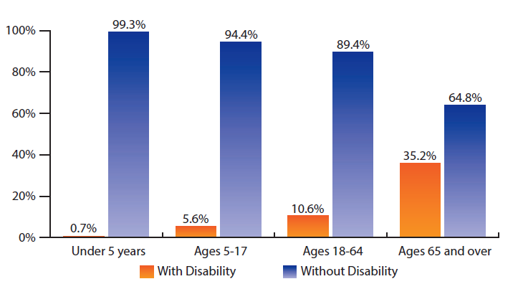
Age Distribution of Disability in the US Population 2016
Data Source: 2008-2016 American Community Survey, American FactFinder, Table B1810
Kraus, L., Lauer, E., Coleman, R., and Houtenville, A. (2018). 2017 Disability Statistics Annual Report. Durham, NH: University of New Hampshire. Available from http://disabilitycompendium.org/sites/default/files/user-uploads/2017AnnualReportSlideDeck
Notes:
The likelihood of reporting a disability increases with age. This slide shows that in the US in 2016, less than 1.0% of the population under 5 years old had disabilities. For those ages 5-17, the rate was 5.6%. For ages 18-64, the rate was 10.6%. For people ages 65 and older, 35.2% had disabilities

Slide 4
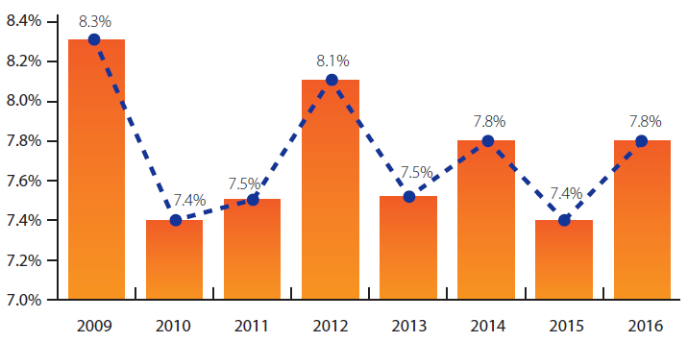
Poverty Percentage Gap, People with/without Disabilities 2009-2016
Data Source: 2008-2016 American Community Survey, American FactFinder, Table B1810
Kraus, L., Lauer, E., Coleman, R., and Houtenville, A. (2018). 2017 Disability Statistics Annual Report. Durham, NH: University of New Hampshire. Available from http://disabilitycompendium.org/sites/default/files/user-uploads/2017AnnualReportSlideDeck
Notes:
The poverty percentage gap, or the difference between the percentages of those with and without disabilities, has been between 7.4 and 8.3 percentage points over the 8 years from 2009 to 2016. The gap was over 8 percentage points in 2009 (8.3) and 2012 (8.1). The other years, the gap ranged from 7.4 (2010 and 2015) to 7.8 percentage points (2014 and 2016).

Slide 5
Disability Demographics in the Future
Growing in numbers as the population ages and with technological advances in care
88.5 million or 20% of the total population will be people 65 and older by 2050
25.4 percent of people age 65 - 74 report disability (2015)
49.8 percent of people over age 75 report disability (2015)
Notes:
88 million people will be over 65 by 2050 and one quarter of people currently over 65 report disability
What does this mean?
Disability is a natural and inevitable aspect of human experience, so it’s important to find mechanisms that will help us stop treating PWDs as outliers or anomalies.
Social policies do not yet take in to account the impact of disability discrimination, lack of appropriate accommodations and inadequate policies on health disparities
* Erickson, W., Lee, C., & von Schrader, S. (2016). 2015 Disability Status Report: United States. Ithaca, NY: Cornell University Yang Tan Institute on Employment and Disability(YTI).

Slide 6
Disability, Health, and Health Care Disparities - Healthy People 2020
People with disabilities are more likely to:
  experience difficulties or delays in getting the health care they need
  not have had an annual dental visit
  not have had a mammogram in the past 2 years
  not have had a Pap test within the past 3 years
  not engage in fitness activities
  have high blood pressure

Slide 7
Why? Complex, Intersecting Barriers Contribute to Disparities
Poverty
Prejudice and stereotypes
Lack of provider training and cultural literacy
Physical and programmatic inaccessibility
Inadequate research
ADA monitoring, implementation and enforcement

Slide 8
Access to Health Care: What Does the ADA Require?
Delivery of services in a way that ensures that all people have an equal opportunity to achieve the full benefit of a program or service (Title II or III)
Notes:
ADD in Michael piece

Slide 9
Access to Health Care: What Does the ADA Require?
Equitable access to care and services includes:
  physical accessibility of buildings and facilities
  accessible equipment
  effective communication
  modification in policies, practices, and procedures
Notes:
To ensure equitable access to care, health care providers must take appropriate steps to ensure that their facilities and offices meet the architectural accessibility requirements of the ADA. Moreover, they must provide effective communication that patients require. For example, patients who are deaf may require a Sign Language interpreter (ASL). Or an individual who has a vision disability may require materials in alternative formats.
Accessible medical equipment such as height-adjustable examination tables ensure that individuals with mobility disabilities can get on the table and be examined. This gives an equal opportunity to receive health care services.
The ADA also requires reasonable modifications in policies, practices, and procedures when necessary to afford goods and services to a person with a disability. For example, reasonable modifications may include modifying the level of language used for some people with cognitive, learning or other intellectual disabilities or modifying standard exam time.
If the health care provider can demonstrate that modifying the policy or practice would fundamentally alter the nature of the goods and services provided, then there is no requirement for the modification.
For more information about the ADA, see the US Department of Justice website at: http://www.ada.gov/

Slide 10
Who Does this Cover?
People with physical, mental, cognitive, or intellectual limitations such as difficulty:
  Walking, balancing, climbing
  Seeing or hearing
  Reading
  Understanding or remembering
Notes:
The ADA Definition of disability

Slide 11
Access to Health Care:
Physical accessibility of buildings and facilities
Notes:
To ensure equitable access to care, health care providers must take appropriate steps to ensure that their facilities and offices meet the architectural accessibility requirements of the ADA. Moreover, they must provide effective communication that patients require. For example, patients who are deaf may require a Sign Language interpreter (ASL). Or an individual who has a vision disability may require materials in alternative formats.
Accessible medical equipment such as height-adjustable examination tables ensure that individuals with mobility disabilities can get on the table and be examined. This gives an equal opportunity to receive health care services.
The ADA also requires reasonable modifications in policies, practices, and procedures when necessary to afford goods and services to a person with a disability. For example, reasonable modifications may include modifying the level of language used for some people with cognitive, learning or other intellectual disabilities or modifying standard exam time.
If the health care provider can demonstrate that modifying the policy or practice would fundamentally alter the nature of the goods and services provided, then there is no requirement for the modification.
For more information about the ADA, see the US Department of Justice website at: http://www.ada.gov/

Slide 12

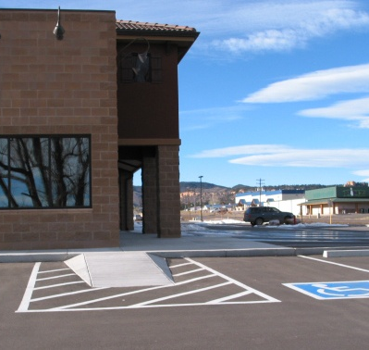
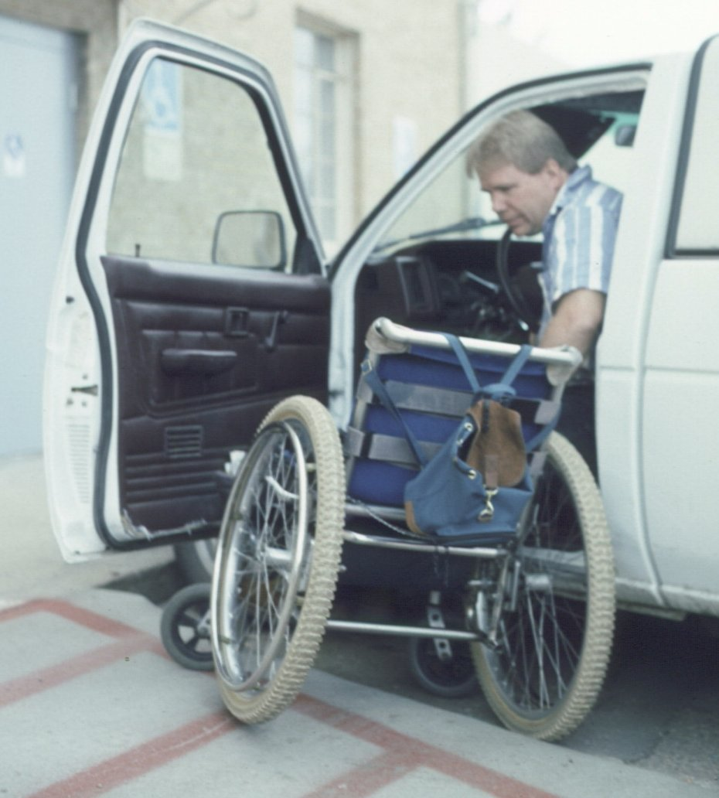
Physical Accessibility of Facilities
Parking
Notes:
2010 Standards define “parking facility” to be inclusive of both parking lots and parking structures. The # of spaces required to be accessible is calculated separately for each facility.
Accessible parking spaces shall be designated as reserved by a sign showing the symbol of accessibility. Spaces complying with 4.1.2(5)(b) shall have an additional sign "Van-Accessible" mounted below the symbol of accessibility. Such signs shall be located so they cannot be obscured by a vehicle parked in the space. Must have 1 van space for every 6 accessible spots.

Slide 13
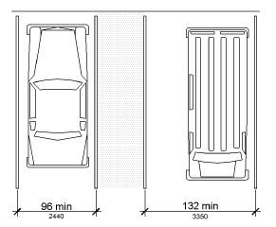
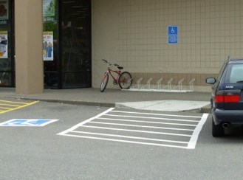
Physical Accessibility of Facilities
Parking
Notes:
In Hospital Outpatient facilities (within a hospital and provide regular and continuing medical treatment without an overnight stay. MUST HAVE 10% of patient and visitor parking compliant.
Doctors’ offices, independent clinics, or other facilities not locate din hospitals are not considered outpatient facilities.
Rehabilitation Facilities and Outpatient Physical Therapy Facilities MUST HAVE 20% of the their parking compliant when they specialize in treating conditions that affect mobility and outpatient physical therapy facilities.
Standard of an eleven foot wide space for vans and a standard five foot wide access aisle. However, the standards will also allow an eight foot wide access aisle as an alternative. Additionally, the access aisle should be marked so it discourages parking with it.
Access aisles can be on either side of a vehicle, except angles parking. In which case, the access aisles must be on the passenger side.
DANA to take it from here – can use these slides or not

Slide 14
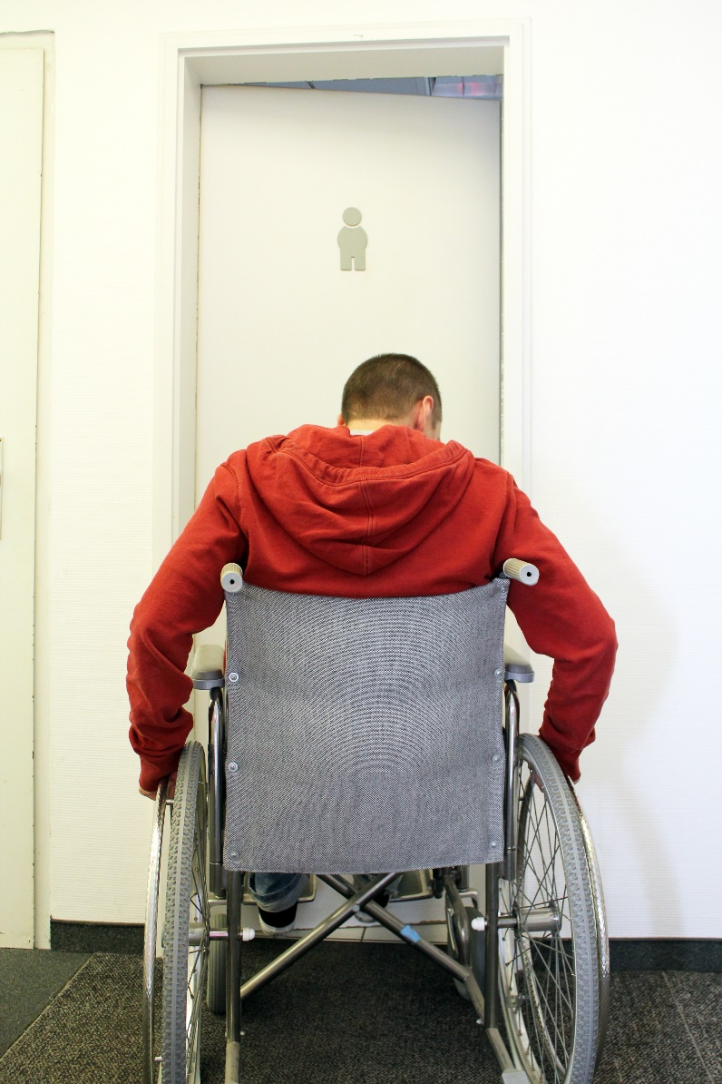
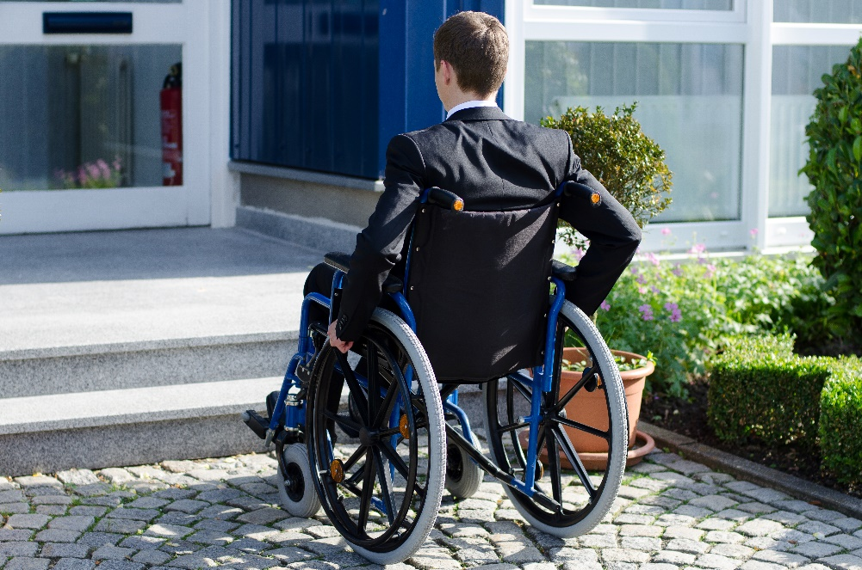
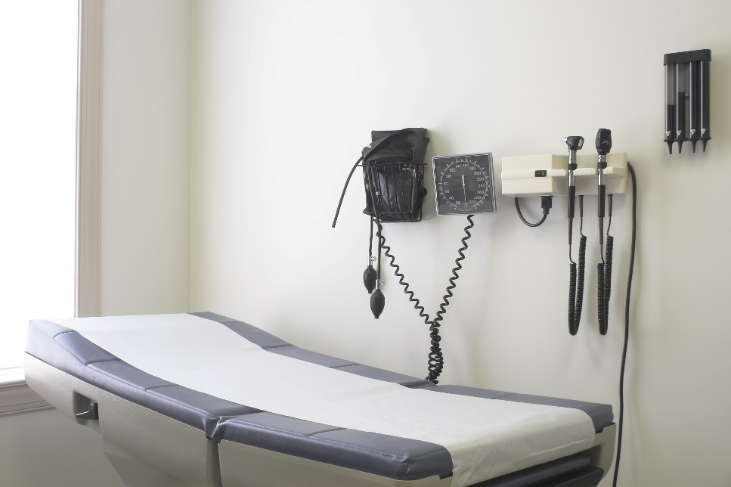
Physical Accessibility of the Office
Buildings, Offices, and Restrooms
Notes:
At least one accessible route shall be provided within the site from the accessible parking spaces and accessible passenger loading zones; public streets and sidewalks; and public transportation stops to the accessible building for facility entrance. At lest 60% of all public entrances must be in compliance. This includes a smooth service on the push side of the door, so wheelchair users don’t get caught up on the door edge.
At least one accessible route shall connect each story and mezzanine in multi-story buildings and facilities.
Entrance doors, doorways, and gates – clear width of 32 inches min., with a clear opening of 90 degrees.

Slide 15
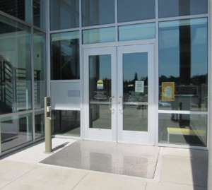
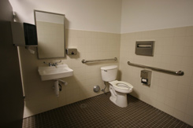
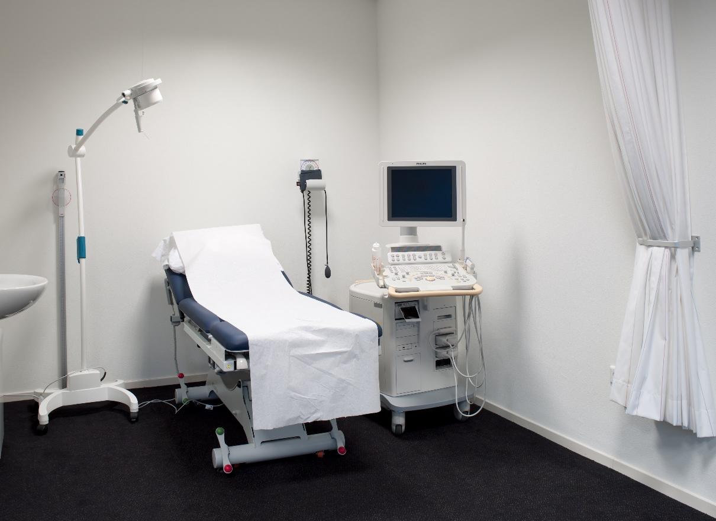
Physical Accessibility of the Office
Buildings, Offices, and Restrooms
Notes:
Exam rooms should have features that make it possible for patients with mobility disabilities to receive appropriate medical care.
An accessible route to and through the room;
An entry door with adequate clear width, maneuvering clearance, and accessible hardware;
Appropriate models and placement of accessible exam equipment;
Adequate clear floor space onside the room for side transfers and use of lift equipment.
The number of accessible exam rooms with accessible equipment varies based on the size of the practice, patient population, and other factors.

Slide 16
Access to Health Care:
Accessible Equipment
Notes:
To ensure equitable access to care, health care providers must take appropriate steps to ensure that their facilities and offices meet the architectural accessibility requirements of the ADA. Moreover, they must provide effective communication that patients require. For example, patients who are deaf may require a Sign Language interpreter (ASL). Or an individual who has a vision disability may require materials in alternative formats.
Accessible medical equipment such as height-adjustable examination tables ensure that individuals with mobility disabilities can get on the table and be examined. This gives an equal opportunity to receive health care services.
The ADA also requires reasonable modifications in policies, practices, and procedures when necessary to afford goods and services to a person with a disability. For example, reasonable modifications may include modifying the level of language used for some people with cognitive, learning or other intellectual disabilities or modifying standard exam time.
If the health care provider can demonstrate that modifying the policy or practice would fundamentally alter the nature of the goods and services provided, then there is no requirement for the modification.
For more information about the ADA, see the US Department of Justice website at: http://www.ada.gov/

Slide 17

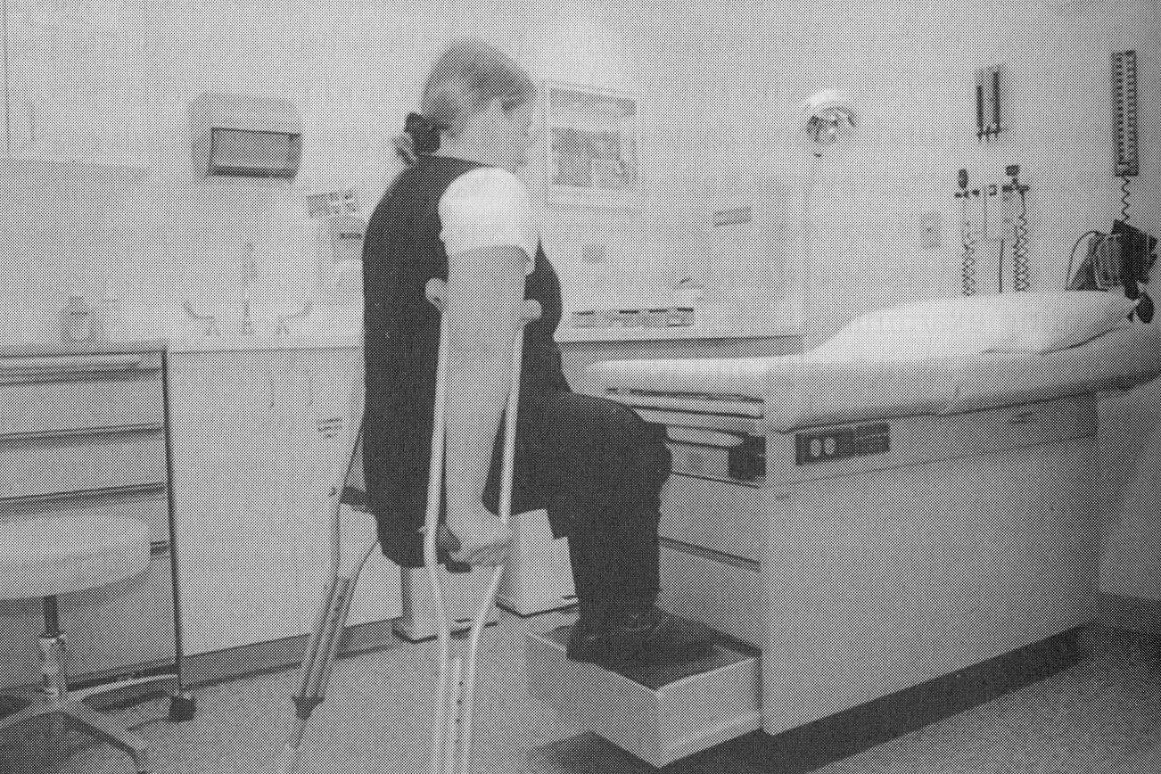
Accessible Equipment
Notes:
Many examination tables are too high for patients with mobility disabilities. Non-adjustable tables make it difficult for patient transfer. Medical staff should ask the patient if he or she needs assistance and, if so, what is the best way to help.
Transfer board or sheet
Steady hand
Accurate measurement of a patient’s weight is essential for diagnostics and treatment (such as knowing the appropriate dosage of a pharmaceutical drug).
Often times, patients who use wheelchairs are not weighed in their doctor’s office.
Understanding and using accessible equipment will minimize the risk of injury to patients and staff.

Slide 18

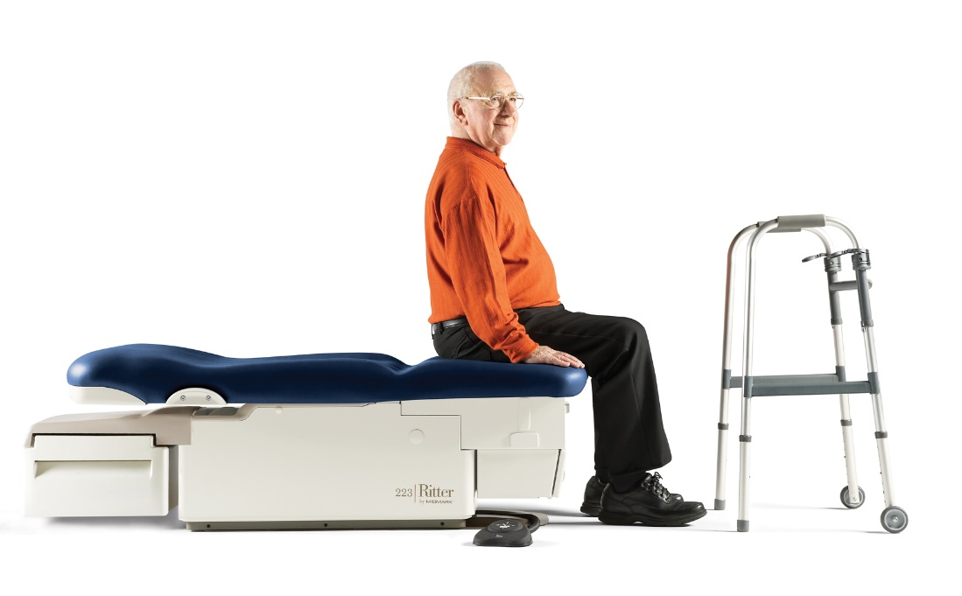
Accessible Equipment
Notes:
At least the following:
Ability to lower to the height of the wheelchair seat, 17-19 inches, or lower to the floor; and
Elements to stabilize and support a person during transfer and while on the table – rails, straps, stabilization, cushions, wedges, etc.
May use a lift in order to transfer some patients safely onto an exam table. Using lifts provides better security for the patient than being lifted by medical staff.
Medical providers should have an accessible scale with a platform large enough to fit a wheelchair, a high weight capacity, for weighing an individuals while seated.
Needs: Edge protection, clear maneuvering space to pull on and off the scale, and a sloped surface.

Slide 19
Physical Accessibility and Accessible Equipment Resources
ADA Standards for Accessible Design (DOJ) https://www.ada.gov/regs2010/2010ADAStandards/2010ADAStandards.pdf
Access to Medical Care For Individuals With Mobility Disabilities (DOJ) https://www.ada.gov/medcare_mobility_ta/medcare_ta.htm
Notes:
You will find medical care facilities mentioned in Chapter 2: Scoping, Chapter 6: Plumbing elements and features, and Chapter 7: Communication features and elements

Slide 20
Physical Accessibility and Accessible Equipment Resources
Pacific ADA Center’s Healthcare and the ADA page https://www.adapacific.org/healthcare#physical-accessibility
  Access to Medical Care for Individuals With Mobility Disabilities 2010 - U.S. Department of Justice (DOJ)
  Accessible Medical Examination Tables and Chairs 2014 - ADA National Network
  Accessible Medical Diagnostic Equipment 2016 - ADA National Network

Slide 21
Physical Accessibility and Accessible Equipment Resources
Pacific ADA Center’s Healthcare and the ADA page https://www.adapacific.org/healthcare#physical-accessibility
  Accessible Parking - ADA National Network
  ADA Checklist For Existing Facilities - New England ADA Center
  ADA Standards for Accessible Design - U.S. Department of Justice (DOJ)
  Increasing the Physical Accessibility of Health Care Facilities - Centers for Medicare & Medicaid Services (CMS)

Slide 22
Access to Health Care:
Effective Communication
Notes:
To ensure equitable access to care, health care providers must take appropriate steps to ensure that their facilities and offices meet the architectural accessibility requirements of the ADA. Moreover, they must provide effective communication that patients require. For example, patients who are deaf may require a Sign Language interpreter (ASL). Or an individual who has a vision disability may require materials in alternative formats.
Accessible medical equipment such as height-adjustable examination tables ensure that individuals with mobility disabilities can get on the table and be examined. This gives an equal opportunity to receive health care services.
The ADA also requires reasonable modifications in policies, practices, and procedures when necessary to afford goods and services to a person with a disability. For example, reasonable modifications may include modifying the level of language used for some people with cognitive, learning or other intellectual disabilities or modifying standard exam time.
If the health care provider can demonstrate that modifying the policy or practice would fundamentally alter the nature of the goods and services provided, then there is no requirement for the modification.
For more information about the ADA, see the US Department of Justice website at: http://www.ada.gov/

Slide 23
Effective Communication
The purpose of the effective communication is to ensure that a person with a vision, hearing, speech, or cognitive disability can communicate with, receive information from, and convey information to, a healthcare provider – in an equal manner.
Healthcare providers must provide auxiliary aids and services when needed to communicate effectively with people who have communication disabilities.
Notes:
MICHAEL to take it from here – can use these slides or not

Slide 24
Effective Communication
The key to communicating effectively is to consider the nature, length, complexity, and context of the communication and the person’s normal method(s) of communication.
The rules apply to communicating with the person who is receiving the services of a healthcare provider, as well as with that person’s parent, spouse, or companion in appropriate circumstances.
Notes:
MICHAEL to take it from here – can use these slides or not

Slide 25
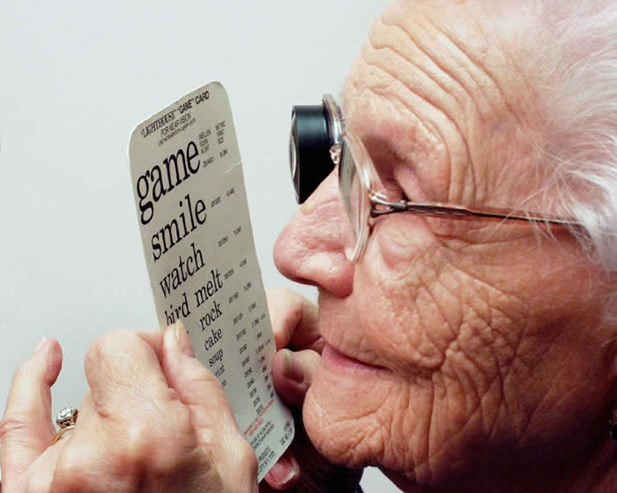
Common Scenario
One woman with low vision reported that she learned only after years of taking her thyroid medication at dinnertime that taking the medication with food weakened the drug’s effects, which may have compromised her treatment.

Slide 26

Common Scenario
A deaf patient ended up in hospital after a heart attack, attributed to medical error (medication prescribed without benefit of an interpreter)
(Medical Interpreting Task Force, WA State)

Slide 27
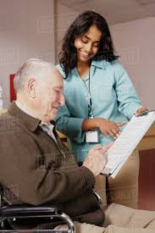



Effective Communication
Auxiliary aids and services for people with vision loss may include:
  Braille
  Large print
  Digital text
  Audio
  Qualified Reader
Notes:
MICHAEL to take it from here – can use these slides or not

Slide 28
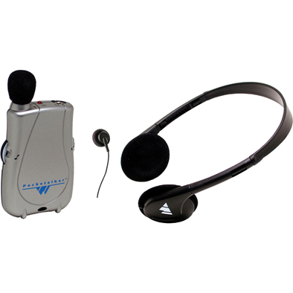

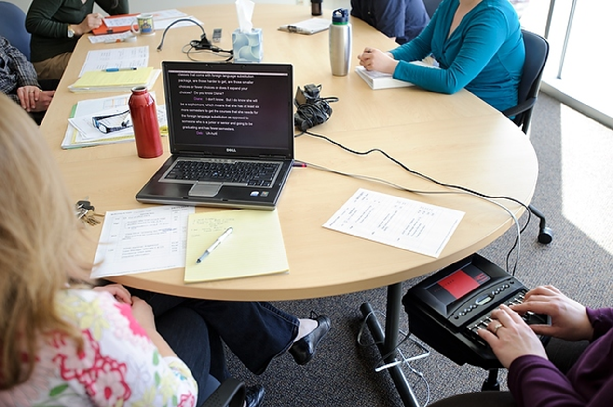
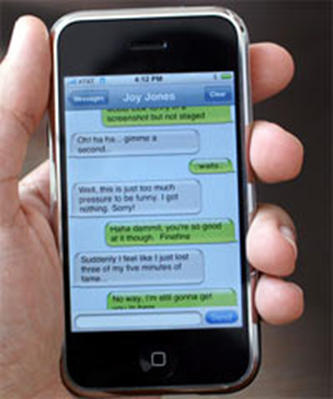

Effective Communication
Auxiliary aids and services for people who are deaf or hard of hearing may include:
  ASL interpreter
  Communication Access Real-time Translation (CART)
  Written materials, transcripts
  Assistive Listening Devices
Notes:
MICHAEL to take it from here – can use these slides or not

Slide 29
Effective Communication
For individuals who are deaf and use sign language, the most effective auxiliary aid or service which a medical office can provide is usually the service of qualified sign language interpreters, who are trained in medical terminology.
ASL is a visual-gestural and rich language that has a different grammatical structure than the English language – reading standard English print, or sharing notes may not be effective!
Do not use family members as ASL interpreters!

Slide 30
Effective Communication Resources
ADA National Network
  https://adata.org/factsheet/communication
DOJ
  Communicating with People Who Are Deaf or Hard of Hearing in Hospital Settings https://www.ada.gov/hospcombr.htm
  Web accessibility https://www.adapacific.org/assets/documents/usdoj-accessibility-of-state-and-local-government-websites.pdf

Slide 31
Effective Communication Resources
National Association for the Deaf
  Questions and Answers for Health Care Providers https://www.nad.org/resources/health-care-and-mental-health-services/health-care-providers/questions-and-answers-for-health-care-providers/
DHHS
  Guidance and Resources for Electronic Information Technology: Ensuring Equal Access To All Health Services And Benefits Provided Through Electronic Means https://www.hhs.gov/sites/default/files/ocr-guidance-electronic-information-technology.pdf?language=es

Slide 32
Access to Health Care:
Modification in Policies, Practices, and Procedures
Notes:
To ensure equitable access to care, health care providers must take appropriate steps to ensure that their facilities and offices meet the architectural accessibility requirements of the ADA. Moreover, they must provide effective communication that patients require. For example, patients who are deaf may require a Sign Language interpreter (ASL). Or an individual who has a vision disability may require materials in alternative formats.
Accessible medical equipment such as height-adjustable examination tables ensure that individuals with mobility disabilities can get on the table and be examined. This gives an equal opportunity to receive health care services.
The ADA also requires reasonable modifications in policies, practices, and procedures when necessary to afford goods and services to a person with a disability. For example, reasonable modifications may include modifying the level of language used for some people with cognitive, learning or other intellectual disabilities or modifying standard exam time.
If the health care provider can demonstrate that modifying the policy or practice would fundamentally alter the nature of the goods and services provided, then there is no requirement for the modification.
For more information about the ADA, see the US Department of Justice website at: http://www.ada.gov/

Slide 33
Modification in Policies, Practices, and Procedures
  Development of a modification process
    How does someone ask for and receive a modification
  Development of staff training
    Disability awareness
    Customer service
    Effective communication (esp. front desk staff)
    Modification request process
Notes:
PAM to take it from here – can use these slides or not

Slide 34
Modification in Policies, Practices, and Procedures Resources
Reasonable modifications
  State and local regulations 35.130(7) from DOJ https://www.ada.gov/regs2010/titleII_2010/titleII_2010_regulations.htm#a35130
  Public accommodations regulations 36.302 from DOJ https://www.ada.gov/regs2010/titleIII_2010/titleIII_2010_regulations.htm#a302

Slide 35
Modification in Policies, Practices, and Procedures Resources
Reasonable modifications resources
  The ADA National Network Disability Law Handbook https://adata.org/publication/disability-law-handbook
  Reaching Out to Customers with Disabilities - Lesson One: Policies, Practices, and Procedures
  https://www.ada.gov/reachingout/title3l1.html

Slide 36
Modification in Policies, Practices, and Procedures Resources
Service animals
  Under the ADA and Section 504 of the Rehabilitation Act of 1973, health care facilities must permit the use of a service animal by a person with a disability, including during a public health emergency or disaster.
    Understanding How to Accommodate Service Animals in Healthcare Facilities
    https://www.phe.gov/Preparedness/planning/abc/Pages/service-animals.aspx
    Assistant Secretary for Preparedness and Response, U.S. Department of Health & Human Services

Slide 37
Modification in Policies, Practices, and Procedures Resources
Service animals resources (page 1 of 2)
  Service Animals Fact Sheet (ADA National Network)
  https://adata.org/factsheet/service-animals
  Service Animals and Emotional Support Animals Booklet (ADA National Network)
  https://adata.org/publication/service-animals-booklet
  Frequently Asked Questions about Service Animals and the ADA
  (U.S. Department of Justice)
  https://www.ada.gov/regs2010/service_animal_qa.html

Slide 38
Modification in Policies, Practices, and Procedures Resources
Service animals resources - page 2 of 2
  ADA Requirements: Service Animals (U.S. Department of Justice)
  https://www.ada.gov/service_animals_2010.htm
  Centers for Disease Control and Prevention: Guidelines for Environmental Infection Control in Health-Care Facilities
  https://www.cdc.gov/infectioncontrol/guidelines/environmental/background/animals.html#h3
  Service Animals in Dental Health Care Settings
  (Centers for Disease Control and Prevention)
  https://www.cdc.gov/oralhealth/infectioncontrol/questions/animals.html

Slide 39
Access to Health Care:
Resources
Notes:
To ensure equitable access to care, health care providers must take appropriate steps to ensure that their facilities and offices meet the architectural accessibility requirements of the ADA. Moreover, they must provide effective communication that patients require. For example, patients who are deaf may require a Sign Language interpreter (ASL). Or an individual who has a vision disability may require materials in alternative formats.
Accessible medical equipment such as height-adjustable examination tables ensure that individuals with mobility disabilities can get on the table and be examined. This gives an equal opportunity to receive health care services.
The ADA also requires reasonable modifications in policies, practices, and procedures when necessary to afford goods and services to a person with a disability. For example, reasonable modifications may include modifying the level of language used for some people with cognitive, learning or other intellectual disabilities or modifying standard exam time.
If the health care provider can demonstrate that modifying the policy or practice would fundamentally alter the nature of the goods and services provided, then there is no requirement for the modification.
For more information about the ADA, see the US Department of Justice website at: http://www.ada.gov/

Slide 40
ADANN Health Care Resources
  Healthcare and the ADA webinar series at www.adapresentations.org
  Healthcare and the ADA factsheets available at www.adata.org (search for Healthcare)
  Regional ADA Center websites with links to state and federal resources (e.g., www.adapacific.org/healthcare)
  ADA questions can be answered at 800-949-4232 or by email
  Training from regional ADA Centers

Slide 41
Barrier-Free Health Care Initiative (DOJ)
  A partnership of the Department of Justice Civil Rights Division and U.S. Attorney’s offices across the nation – resource for court cases
  Target enforcement efforts on a critical area for individuals with disabilities
  Launched on the 22nd anniversary of the ADA in July 2012
  https://www.ada.gov/usao-agreements.htm
Notes:
QUESTION - use these slides or not.
QUESTION – show other non-ADANN resources? MMCO, with the ICRC and RIC, as well as Office of Minority Health are possibilities

Slide 42




Contact Us
ADA National Network Technical Assistance Hotline
1-800-949-4232 (free and confidential answers on the ADA)
Lewis Kraus, Pacific ADA Center
lewisk@adapacific.org
Michael Richardson, Northwest ADA Center
mike67@uw.edu
Dana Barton, Rocky Mountain ADA Center
dbarton@mtc-inc.com
Pam Williamson, Southeast ADA Center
prwill01@law.syr.edu

